Slide 1
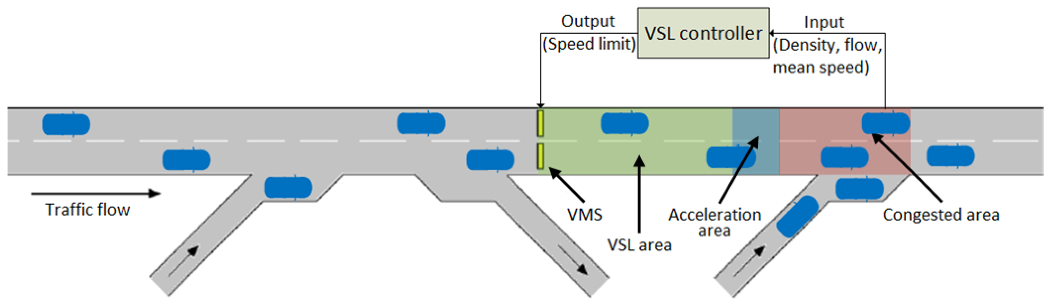
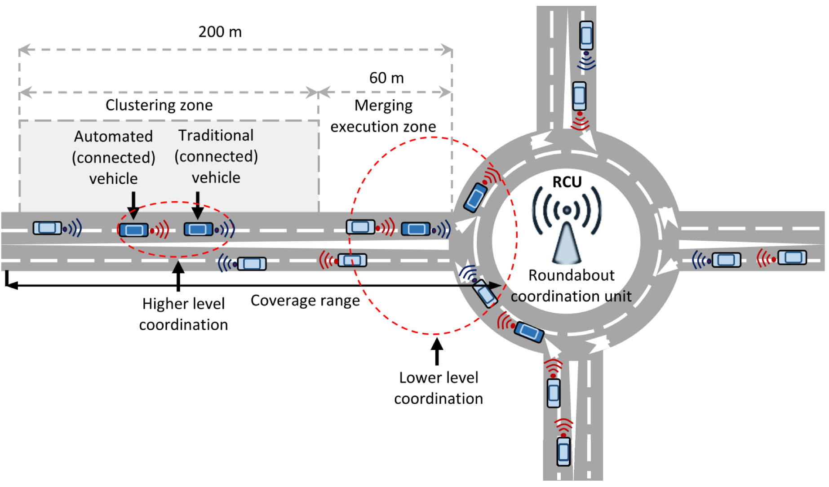
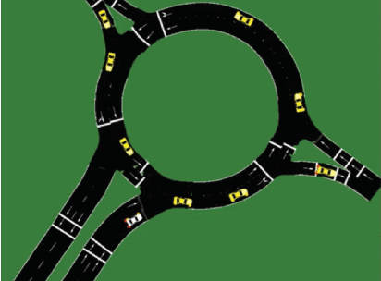
Establishment of scenario strategies according to dangerous driving situations Researcher : Choi Jae Won
What is the problem?
Autonomous vehicles do not always have good situational awareness
Changes in weather conditions or road geometry may limit autonomous vehicle information acquisition
Lack of detailed settings for the help that infrastructure can provide
Why is this problem important?
I2V as well as V2V can help a lot to increase traffic safety, but clear guidance is needed
Determining a data collection and delivery method suitable for the situation can reduce communication and calculation time.
Unsafe driving scenarios for autonomous vehicles need to be identified and improved through infrastructure devices
Establishing an unsafe driving scenario according to the situation is a great help in increasing the safety of the road network
How can we solve this problem?
By setting the risk situation and the data to be collected and transmitted in detail, it is intended to present a strategy that can respond appropriately to the three risk situations
The three situations assume a general situation and a situation in which bad weather or visibility is blocked at road junctions, roundabouts, and non-signal intersections
Distinguish between general and bad weather road surface conditions and transmit vehicle position and speed data
Evaluate the effectiveness of the strategy by calculating the risk potential of the vehicle through data transmission and reception of SSM using roadside facilities before the occurrence of a problem situation
Evaluate the effectiveness of the strategy by incorporating the risk section as a part of the network and checking the effect on the entire network
Network safety evaluation
What is key contribution?
Developing an infrastructure unit strategy that can increase the stability of the road network
Defining the most effective and efficient RSE location and sending and receiving data

